Slide 1
Super-Automatic Espresso Machine
University of Utah
Nathan Donaldson
Ben Nagel Aaron Pabst
Notes:
Hi. our names are unimportant. You don’t want to be here. Neither do we. We’re building an espresso machine on speed. Introduction complete.

Slide 2
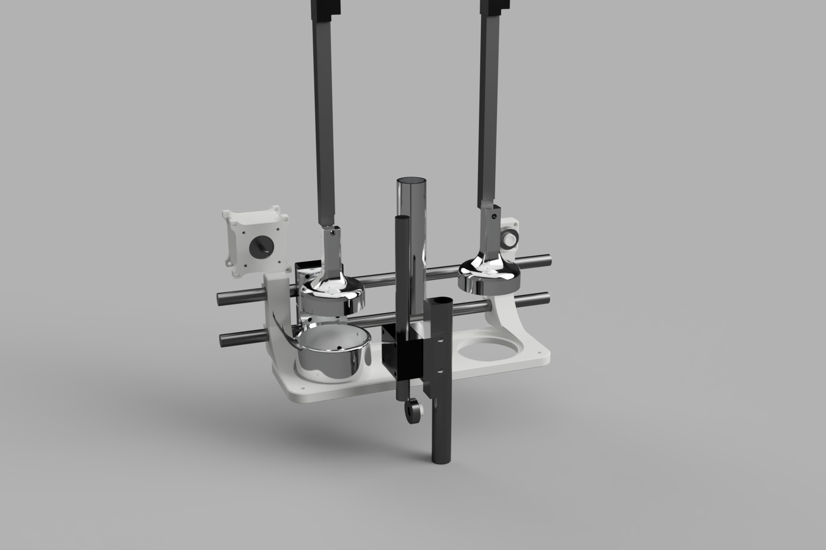
Render goes here

Slide 3
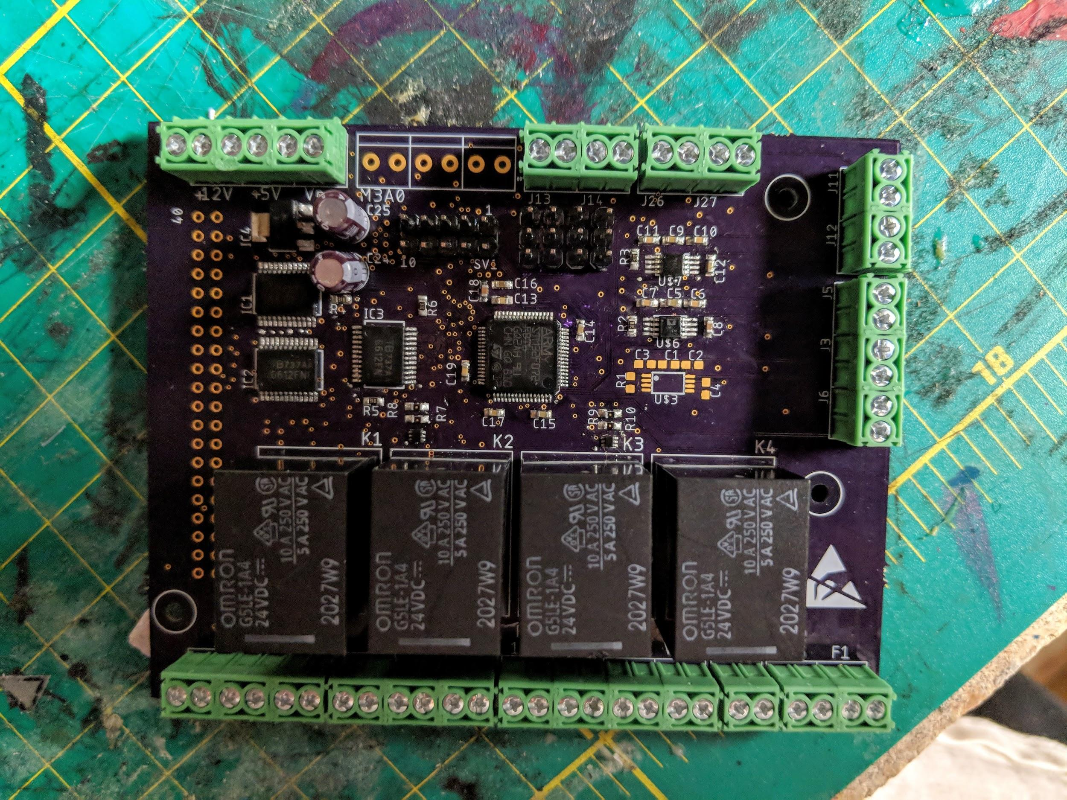
PCB picture goes here

Slide 4
Remaining Electro-Mechanical Tasks
Fabricate frothing mechanism
Build housing around mechanisms

Slide 5
Embedded Software
Bulk of the remaining work

Slide 6
Flask
Flask is a Python MicroFramework that assists in the creation of websites.
We will be using it as a REST server that is running on a Raspberry Pi.
This Provides us with
Access from anyone on the network
Reliability through HTTP
Acts as a middleman between the Android Phone and the microcontroller

Slide 7
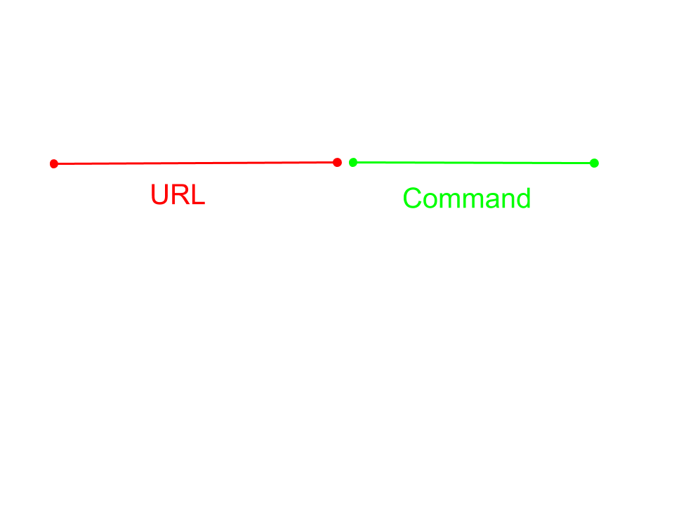
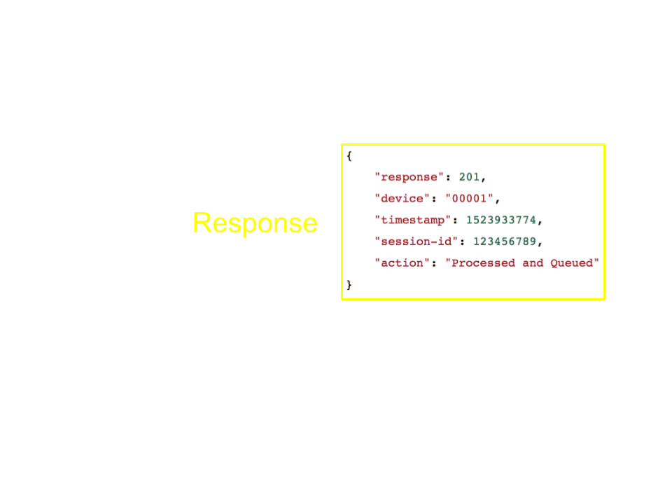
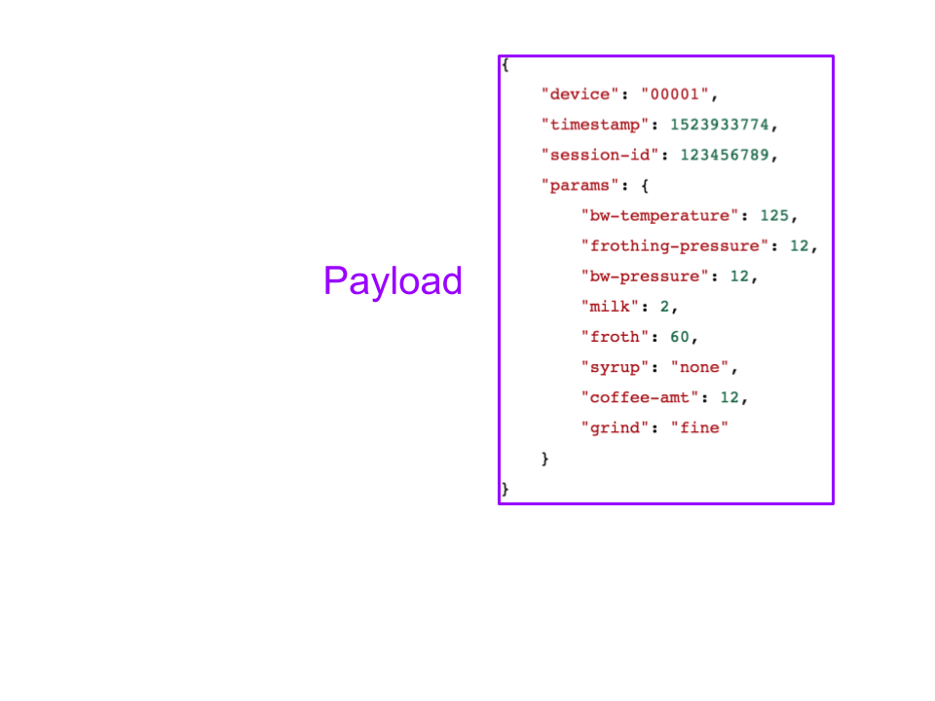
Flask Requests
Flask will setup the website http://127.0.0.1:5000 for anyone on the local network to reach.
It will recognize valid requests as having the machine serial number in the json payload.

Slide 8
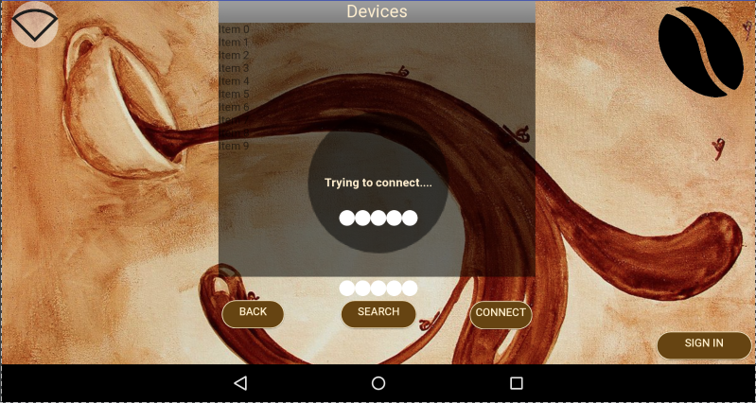
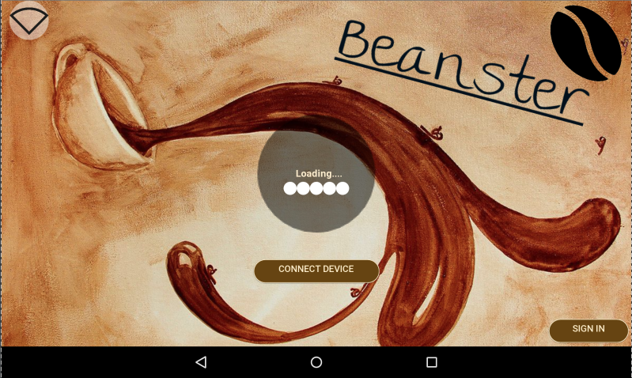
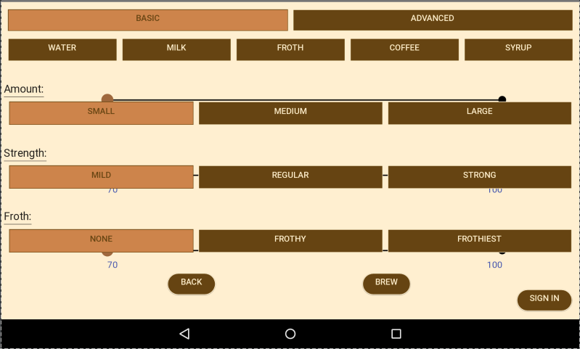
Displays...
*Top and bottom login fragments as well.*

Slide 9
Mobile plans...
User logins (local information, STRETCH for backend)
Aesthetics
Additional user features:
Favorite brew settings saved
Recents (If there is time)
Etc.

Slide 10
Database Goals (Stretch)
Use a database such as Google’s Firebase or AWS
Requires RaspberryPi to act as router
Services easily implemented
Implement user profiles
Mobile application will send login info and receive info
Data aggregation for features like Searching and Recommendations
Allow users to upload drink recipes, scheduled posts about machine statistics

Slide 11
Overview of Progress
Mobile App (95% complete)
Flask Server (90% complete)
PCB Design (100% complete)
PCB Assembly (100% complete)
App to Flask (100% complete)
Flask to PCB (90% complete)
Design (80% complete)
Part Procurement (100% complete)
PCB Programming (10% complete)
Assembly (10% complete)

Slide 12
Questions?
Notes:
We will now answer whatever asinine questions you’ve managed to come up with.

